Slide 1


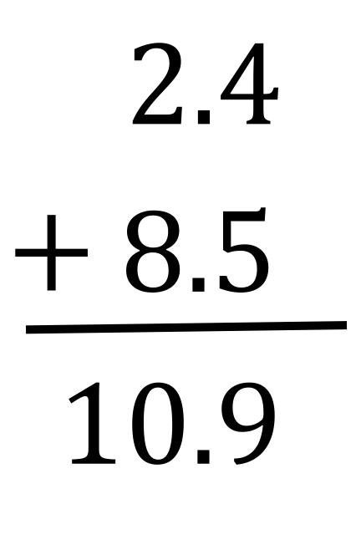
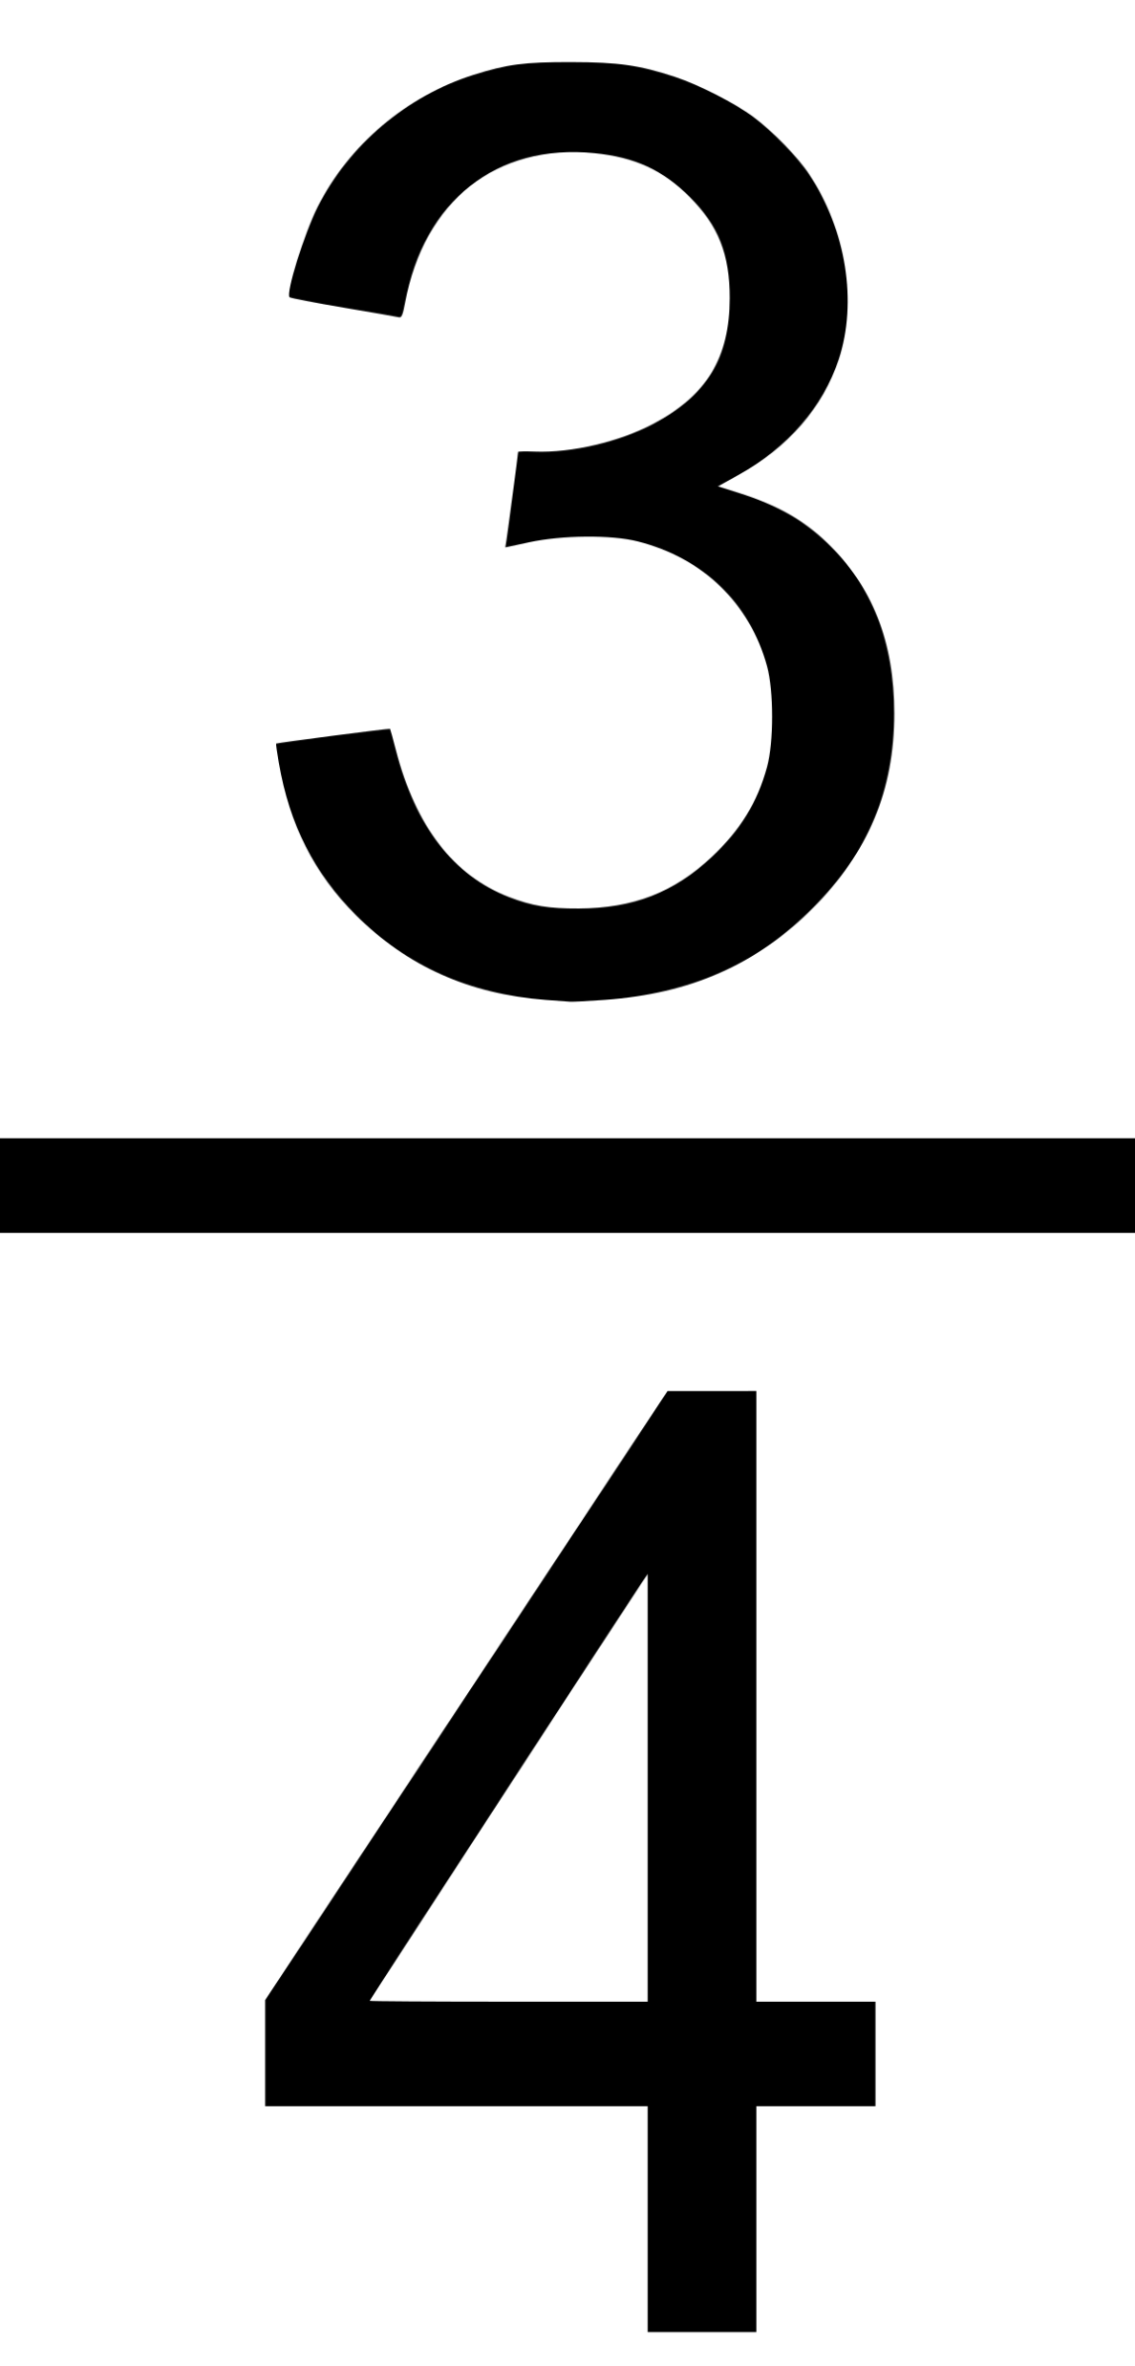


Percentage
Decimal
Fraction
Play the game …… Play the game ….
Original Idea by Josh
Supervised by Josh
Coded by Mum
Catering by Nanny
This Photo by Unknown Author is licensed under CC BY-SA

